Slide 1
HASH TABLES
Hash Tables are abstract data types (ADT) that support very efficient
  insert
  remove
  find
operations. These operations can all be implemented in (almost) constant time.

Slide 2
HASH TABLES
However, hash tables do not support efficient findMax, findMin, printing in sorted order.
  findMax and findMin take O(N) time (was O(log N) with BSTs)
  printing in sorted order takes O(N log N) time (was O(N) with BSTs using in-order traversal)

Slide 3
BASIC IDEA
Arrays provide the fastest mechanism for accessing data

Slide 4
BASIC IDEA
Arrays provide the fastest mechanism for accessing data
  given an index, you can access the data at that position in O(1) time.

Slide 5
BASIC IDEA
Arrays provide the fastest mechanism for accessing data
  given an index, you can access the data at that position in O(1) time.
  given an index of unused position, you can insert an element in O(1) time.
  given an index of used position, you can delete an element in O(1) time.

Slide 6
BASIC IDEA
But, there are two problems:

Slide 7
BASIC IDEA
But, there are two problems:
  The array has a fixed size of some K elements. How do we store more elements?

Slide 8
BASIC IDEA
But, there are two problems:
  The array has a fixed size of some K elements. How do we store more elements?
    This actually is a minor problem! We can occasionally resize the array if it gets full.

Slide 9
BASIC IDEA
But, there are two problems:
  The array has a fixed size of some K elements. How do we store more elements?
    This actually is a minor problem! We can occasionally resize the array if it gets full.
  The more important problem is that we do NOT search by using an index; rather we use the value of the data element to search.

Slide 10
BASIC IDEA
But, there are two problems:
  The array has a fixed size of some K elements. How do we store more elements?
    This actually is a minor problem! We can occasionally resize the array if it gets full.
  The more important problem is that we do NOT search by using an index; rather we use the value of the data element to search.
    Thus we need to compute an index from the value of the data element.

Slide 11
BASIC IDEA
Space of possible values
of the data elements
(possibly infinite!)
Space of possible values
of the indices
(0 to K-1)
0
Mapping
x₁
.
x₂
.
x₃
. . . . . . .
.
x₄
K - 1

Slide 12
BASIC IDEA
Space of possible values
of the data elements
(possibly infinite!)
Space of possible values
of the indices
(0 to K-1)
0
Mapping
x₁
.
x₂
.
x₃
. . . . . . .
.
x₄
hash: X ⇒ {0,...,K–1}
K – 1

Slide 13
BASIC IDEA
Space of possible values
of the data elements
(possibly infinite!)
Space of possible values
of the indices
(0 to K-1)
0
Mapping
x₁
.
x₂
.
x₃
. . . . . . .
.
x₄
Hash(ing) function
hash: X ⇒ {0,...,K–1}
K – 1

Slide 14
HASH FUNCTION EXAMPLE
Suppose my data elements, X, are 32 bit unsigned integers, and I want to store them in an array of 256 elements.

Slide 15
HASH FUNCTION EXAMPLE
Suppose my data elements, X, are 32 bit unsigned integers, and I want to store them in an array of 256 elements.
32 bit integers are composed of 4 8-bit bytes.

Slide 16
HASH FUNCTION EXAMPLE
Suppose my data elements,X, are 32 bit unsigned integers, and I want to store them in an array of 256 elements.
32 bit integers are composed of 4 8-bit bytes.
Assume the hash function hash(X) extracts the lowest order byte and returns its value.

Slide 17
HASH FUNCTION EXAMPLE
Assume the hash function hash(X) extracts the lowest order byte and returns its value.
  X = 0 = (0,0,0,0) ⇒ 0

Slide 18
HASH FUNCTION EXAMPLE
Assume the hash function hash(X) extracts the lowest order byte and returns its value.
  X = 0 = (0,0,0,0) ⇒ 0
  X = 1025 = (0,0,4,1) ⇒ 1

Slide 19
HASH FUNCTION EXAMPLE
Assume the hash function hash(X) extracts the lowest order byte and returns its value.
  X = 0 = (0,0,0,0) ⇒ 0
  X = 1025 = (0,0,4,1) ⇒ 1
  X = 65541 = (0,1,0,5) ⇒ 5

Slide 20
HASH FUNCTION EXAMPLE
Assume the hash function hash(X) extracts the lowest order byte and returns its value.
  X = 0 = (0,0,0,0) ⇒ 0
  X = 1025 = (0,0,4,1) ⇒ 1
  X = 65541 = (0,1,0,5) ⇒ 5
  X = 256 = (0,0,1,0) ⇒ 0

Slide 21
HASH FUNCTION EXAMPLE
Assume the hash function hash(X) extracts the lowest order byte and returns its value.
  X = 0 = (0,0,0,0) ⇒ 0
  X = 1025 = (0,0,4,1) ⇒ 1
  X = 65541 = (0,1,0,5) ⇒ 5
  X = 256 = (0,0,1,0) ⇒ 0 (PROBLEM!)
Two X values map to a single index value. This is known as a COLLISION.

Slide 22
HASH FUNCTION EXAMPLE
Assume the domain of X is the set of possible strings of any length (again we have an array of 256 elements!)
  Chop the string into bytes
  Add the bytes modulo 256
  Store them at the location indicated by the sum.

Slide 23
HASH FUNCTION EXAMPLE
Assume the domain of X is the set of possible strings of any length (with the same size array)
  Chop the string into bytes
  Add the bytes modulo 256
  Store the string at the location indicated by the sum.
    X =“kemal” = (107,101,109,97,108) ⇒ 512 mod 256 = 0
    X= “volkan” = (118,111,108,107,97,110) ⇒ 651 mod 256 = 139
    X = “lamek” = (108,97,109,101,107) ⇒ 512 mod 256 = 0 (Collision)

Slide 24
HASH FUNCTIONS
Note that even though size of the domain from which the values of X come may be large, the number of distinct values that we store can be very small, perhaps smaller than the array size.
So collisions may occur but there may be lots of empty slots in the array!

Slide 25
HASH FUNCTIONS
The fundamental problems in hash tables are:
  finding that perfect hash function, so that there are no collisions

Slide 26
HASH FUNCTIONS
The fundamental problems in hash tables are:
  finding that perfect hash function, so that there are no collisions
    This is not possible since for interesting cases the domain of X is much larger than the number of slots in the array, so there will always be collisions

Slide 27
HASH FUNCTIONS
The fundamental problems in hash tables are:
  finding that perfect hash function, so that there are no collisions
    This is not possible since for interesting cases the domain of X is much larger than the number of slots in the array, so there will always be collisions
  This having failed, developing mechanisms so that collisions are handled in a certain way

Slide 28
HASH FUNCTIONS
Should be deterministic
Should be easy to compute, i.e., in O(1) time
Should distribute the elements evenly among the cells in the Hash Table, so that collisions are avoided as much as possible

Slide 29
SOME HASH FUNCTIONS
int hash (const int key, const int tableSize)
{
return (key % tableSize)
}
This function maps integers to
integers 0 .... tableSize – 1
Although this is generally a reasonable strategy, some care must be taken
For example, if the tableSize is 10 and the keys all end in zero, then this hash function is a bad choice

Slide 30
SOME HASH FUNCTIONS
For most applications, the key (of the data element to be stored) is a character string of some sort.

Slide 31
SOME HASH FUNCTIONS
int hash (const string & key, int tableSize)
{
int sum = 0;
for (int i = 0; i < key.length(); i++) // add all bytes in a loop
sum = sum + key[ i ];
return (sum % tableSize);
}
This function maps character strings to
integers 0 .... tableSize – 1
Again some care must be taken
For example, if the keys are eight or fewer characters long, this hash function will return a value between 0 and 1016, which is 8*127 (The value of an ASCII character <= 127)
If we have a table of about 10000 slots, this function will map string keys to only about 1/10 of the table

Slide 32
SOME HASH FUNCTIONS
int hash (const string & key, int tableSize)
{
return ( key[ 0 ] + 27 * key[ 1 ] + 729 * key[ 2 ] ) % tableSize;
}
This function maps character strings to
integers 0 .... tableSize – 1

Slide 33
SOME HASH FUNCTIONS
int hash (const string & key, int tableSize)
{
return ( key[ 0 ] + 27 * key[ 1 ] + 729 * key[ 2 ] ) % tableSize;
}
This function maps character strings to
integers 0 .... tableSize – 1
But we want the strings to have at least 3 characters and we just use those characters

Slide 34
SOME HASH FUNCTIONS
int hash (const string & key, int tableSize)
{
return ( key[ 0 ] + 27 * key[ 1 ] + 729 * key[ 2 ] ) % tableSize;
}
This function maps character strings to
integers 0 .... tableSize – 1
But we want the strings to have at least 3 characters and we just use those characters
For English words there are 26³ = 17,576 possible 3 letter combinations, but only around 2800 are actual possible sequences

Slide 35
SOME HASH FUNCTIONS
int hash (const string & key, int tableSize)
{
return ( key[ 0 ] + 27 * key[ 1 ] + 729 * key[ 2 ] ) % tableSize;
}
For English words there are 26³ = 17,576 possible 3 letter combinations, but only around 2800 are actual possible sequences
If we have table of about 10000 slots, and even if none of these combinations collide we will only use about ¼ of the table

Slide 36
SOME HASH FUNCTIONS
This function uses all characters.
int hash (const string & key, int tableSize)
{
int hashVal = 0;
for (int i = 0; i < key.length();i++)
hashVal = 37 * hashVal + key[ i ];
hashVal = hashVal % tableSize;
if (hashVal < 0)
hashVal = hashVal + tableSize;
return(hashVal);
}

Slide 37
SOME HASH FUNCTIONS
This function uses all characters.
It computes a polynomial with the characters as the coefficients and 37 as the variable value, using Horner’s method.
int hash (const string & key, int tableSize)
{
int hashVal = 0;
for (int i = 0; i < key.length();i++)
hashVal = 37 * hashVal + key[ i ];
hashVal = hashVal % tableSize;
if (hashVal < 0)
hashVal = hashVal + tableSize;
return(hashVal);
}

Slide 38
SOME HASH FUNCTIONS
This function uses all characters.
It computes a polynomial with the characters as the coefficients and 37 as the variable value, using Horner’s method.
Since overflows may occur, any negative sum is fixed here.
int hash (const string & key, int tableSize)
{
int hashVal = 0;
for (int i = 0; i < key.length();i++)
hashVal = 37 * hashVal + key[ i ];
hashVal = hashVal % tableSize;
if (hashVal < 0)
hashVal = hashVal + tableSize;
return(hashVal);
}

Slide 39
HASH TABLE SIZE
For various theoretical reasons, the sizes of the arrays (tableSize) should preferably be prime numbers (and preferably close to powers of two)
Such numbers usually give a better distribution of keys and reduce collisions

Slide 40
HANDLING COLLISIONS
Apart from the hash function, the main issue in hash tables is how to handle collisions

Slide 41
HANDLING COLLISIONS
Apart from the hash function, the main issue in hash tables is how to handle collisions
  separate chaining
  open addressing

Slide 42
SEPARATE CHAINING
This is a very simple idea
Each array entry holds, not an element X, but points to a list of such elements

Slide 43
SEPARATE CHAINING
This is a very simple idea
Each array entry holds, not an element X, but points to a list of such elements
Each entry on a list hashes to the same value and hence, collide

Slide 44
SEPARATE CHAINING
This is a very simple idea
Each array entry holds, not an element X, but points to a list of such elements
Each entry on a list hashes to the same value and hence, collide
So, most lists have a single entry, some have more than 1

Slide 45
SEPARATE CHAINING
Suppose we would like to store
  100, 121, 144, 169, 196, 225, 256, 289, 324, 361
  using a hash table of 10 slots
  with the hash function X mod 10

Slide 46
SEPARATE CHAINING
Initially the hash table is empty
0
1
2
3
4
5
6
7
8
9

Slide 47
SEPARATE CHAINING
Insert 100
0
100
1
2
3
4
5
6
7
8
9

Slide 48
SEPARATE CHAINING
Insert 121
0
100
1
121
2
3
4
5
6
7
8
9

Slide 49
SEPARATE CHAINING
Insert 144
0
100
1
121
2
3
4
144
5
6
7
8
9

Slide 50
SEPARATE CHAINING
Insert 169
0
100
1
121
2
3
4
144
5
6
7
8
9
169

Slide 51
SEPARATE CHAINING
Insert 196
0
100
1
121
2
3
4
144
5
6
196
7
8
9
169

Slide 52
SEPARATE CHAINING
Insert 225
0
100
1
121
2
3
4
144
5
225
6
196
7
8
9
169

Slide 53
SEPARATE CHAINING
Insert 256, COLLISION
0
100
1
121
2
3
4
144
5
225
6
196
256
7
8
9
169

Slide 54
SEPARATE CHAINING
Insert 289, COLLISION
0
100
1
121
2
3
4
144
5
225
6
196
256
7
8
9
169
289

Slide 55
SEPARATE CHAINING
Insert 324, COLLISION
0
100
1
121
2
3
4
144
324
5
225
6
196
256
7
8
9
169
289

Slide 56
SEPARATE CHAINING
Insert 361, COLLISION
0
100
1
121
361
2
3
4
144
324
5
225
6
196
256
7
8
9
169
289

Slide 57
SEPARATE CHAINING
template <class HashedObj>
class HashTable
{
public:
HashTable( const HashedObj & notFound,
int size = 101 );
HashTable( const HashTable & rhs )
: ITEM_NOT_FOUND( rhs.ITEM_NOT_FOUND ),
theLists( rhs.theLists ) { }
const HashedObj & find( const HashedObj & x ) const;
void makeEmpty( );
void insert( const HashedObj & x );
void remove( const HashedObj & x );
const HashTable & operator=( const HashTable & rhs);

Slide 58
SEPARATE CHAINING
private:
vector<List<HashedObj> > theLists;
// The array of Lists
const HashedObj ITEM_NOT_FOUND;
};
int hash( const string & key, int tableSize );
int hash( int key, int tableSize );
Note that since these are not already defined for type int and class string
we define them as external function, distinguished only
by the type of the argument, at compile time.

Slide 59
HASHED OBJECTS
The hash table class works for classes that provide
  operator== (or operator!=, or both)
  hash function
For technical reasons, the hash function is not a method, but a function explicitly provided.

Slide 60
EXAMPLE HASHED OBJECT
// Employee class
class Employee {
public:
bool operator==(const Employee &rhs) const;
{return(id == rhs.id);}
bool operator!=(const Employee &rhs) const;
{return !(*this == rhs);}
......
private:
int id;
string name;
double salary;
....
}
int hash(const Employee & employee, tableSize)
{ return(hash(employee.id, tableSize)); }
Notes:
equal-to operator
not-equal-to operator

Slide 61
CONSTRUCTOR
/**
* Construct the hash table.
*/
template <class HashedObj>
HashTable<HashedObj>::HashTable( const HashedObj & notFound, int size )
: ITEM_NOT_FOUND( notFound ), theLists( nextPrime( size ) )
{
}

Slide 62
(private) nextPrime
/**
* Internal method to return a prime number at least as large as n.
* Assumes n > 0.
*/
int nextPrime( int n )
{
if( n % 2 == 0 )
n++;
for( ; !isPrime( n ); n += 2 )
;
return n;
}

Slide 63
(private) isPrime
/**
* Internal method to test if a positive number is prime.
* Not an efficient algorithm.
*/
bool isPrime( int n )
{
if( n == 2 || n == 3 )
return true;
if( n == 1 || n % 2 == 0 )
return false;
for( int i = 3; i * i <= n; i += 2 )
if( n % i == 0 )
return false;
return true;
}

Slide 64
makeEmpty
/**
* Make the hash table logically empty.
*/
template <class HashedObj>
void HashTable<HashedObj>::makeEmpty( )
{
for( int i = 0; i < theLists.size( ); i++ )
theLists[ i ].makeEmpty( ); // destroy the lists but not the vector!
}

Slide 65
insert
/**
* Insert item x into the hash table. If the item is
* already present, then do nothing.
*/
template <class HashedObj>
void HashTable<HashedObj>::insert( const HashedObj & x )
{
// hash the given object and locate the list it should be on
List<HashedObj> & whichList = theLists[ hash( x, theLists.size( ) ) ];
// locate the object in the list (using List’s find)
ListItr<HashedObj> itr = whichList.find( x );
//insert the new item at the head of the list if not found!
if( itr.isPastEnd( ) )
whichList.insert( x, whichList.zeroth( ) );
}

Slide 66
remove
/**
* Remove item x from the hash table.
*/
template <class HashedObj>
void HashTable<HashedObj>::remove( const HashedObj & x )
{
// remove from the appropriate list
theLists[ hash( x, theLists.size( ) ) ].remove( x );
}

Slide 67
find
/**
* Find item x in the hash table.
* Return the matching item or ITEM_NOT_FOUND if not found
*/
template <class HashedObj>
const HashedObj & HashTable<HashedObj>::
find( const HashedObj & x )const
{
ListItr<HashedObj> itr;
// locate the approriate list and search there
itr = theLists[ hash( x, theLists.size( ) ) ].find( x );
// retrieve from the located position
if( itr.isPastEnd( ) )
return ITEM_NOT_FOUND;
return itr.retrieve( );
}

Slide 68
PERFORMANCE
We define the load factor, λ, of a hash table as the ratio of the number of elements (N) to the size of the table (M).
In the insertion example we gave earlier, λ = 1.0, and the average list length is λ.

Slide 69
PERFORMANCE
Search Time
  time to compute the hash function = O(1) (this time is dependent on the size of the key, but is NOT dependent on N).

Slide 70

PERFORMANCE
Search Time
  time to compute the hash function = O(1) (this time is dependent on the size of the key, but is NOT dependent on N).
  Unsuccessful Search
    λ nodes have to be traversed on the average.
searching index | nodes visited
0 | N₀
1 | N₁
2 | N₂
... | N...
M-1 | N_{M-1}
0
N₀
1
N₁
2
N₂
...
N...
M-1
N_{M-1}

Slide 71
PERFORMANCE
Search Time
  time to compute the hash function = O(1) (this time is dependent on the size of the key, but is NOT dependent on N).
  Unsuccessful Search
    λ nodes have to be traversed on the average.
  Successful Search
    About 1 + λ/2 nodes have to be traversed:
      1 for the successful matching node
      0 or more non-matching other nodes.
      There are an expected (N-1)/M other nodes on a list = λ-1/M ≅ λ since M is large. On the average ½ of such nodes are searched in a find.

Slide 72
PERFORMANCE
So the load factor λ is important.
Make the table at least as large as the expected number of elements you want to store so that λ ≤ 1.

Slide 73
PERFORMANCE
So the load factor λ is important.
Make the table at least as large as the expected number of elements you want to store so that λ ≤ 1.
Choose a prime M, so that there is a good distribution.

Slide 74
EVALUATION
Separate chaining is a conceptually simple data structure.
But it has the disadvantage of using linked lists.
This tends to slow down the operations a bit due to new allocations.
One needs to use 3 classes: HashedObj, List, HashTable

Slide 75
OPEN ADDRESSING
Open addressing is an alternative to resolving collusions with linked lists.

Slide 76
OPEN ADDRESSING
Open addressing is an alternative to resolving collusions with linked lists.
Suppose an item X hashes to table position hash(x)
If there is a collision at the location found by hash(x) then

Slide 77
OPEN ADDRESSING
If there is a collision at the location found by hash(x) then locations
  h_{i}(x) = (hash(x) + f(i)) mod M (M= table size) are tried for i = 1,2,.... until an empty cell is found.
  the function f(i) is the collision resolution strategy function.

Slide 78
OPEN ADDRESSING
If there is a collision at the location found by hash(x) then locations
  h_{i}(x) = (hash(x) + f(i)) mod M (M= table size) are tried for i = 1,2,.... until an empty cell is found.
  the function f(i) is the collision resolution strategy function.
  So we get different strategies for different functions f.

Slide 79
OPEN ADDRESSING
Linear probing
  f(i) = i

Slide 80
OPEN ADDRESSING
Linear probing
  f(i) = i
Quadratic probing
  f(i) = i²

Slide 81
OPEN ADDRESSING
Linear probing
  f(i) = i
Quadratic probing
  f(i) = i²
Double hashing
  f(i) = i ⋅ hash₂(x)

Slide 82
LINEAR PROBING
In linear probing, the function f is a linear function of i, typically, f(i) = i.

Slide 83
LINEAR PROBING
In linear probing, the function f is a linear function of i, typically, f(i) = i.
One tries positions sequentially (with wrap-around) starting with the hashed position.

Slide 84
LINEAR PROBING
Suppose we would like to store
  100, 121, 144, 169, 196, 225, 256, 289, 324, 361
  using a hash table of 10 slots
  with the hash function X mod 10.
  with f(i) = i.

Slide 85
LINEAR PROBING
Initially the hash table is empty
0
1
2
3
4
5
6
7
8
9

Slide 86
LINEAR PROBING
Insert 100
0
100
1
2
3
4
5
6
7
8
9

Slide 87
LINEAR PROBING
Insert 121
0
100
1
121
2
3
4
5
6
7
8
9

Slide 88
LINEAR PROBING
Insert 144
0
100
1
121
2
3
4
144
5
6
7
8
9

Slide 89
LINEAR PROBING
Insert 169
0
100
1
121
2
3
4
144
5
6
7
8
9
169

Slide 90
LINEAR PROBING
Insert 196
0
100
1
121
2
3
4
144
5
6
196
7
8
9
169

Slide 91
LINEAR PROBING
Insert 225
0
100
1
121
2
3
4
144
5
225
6
196
7
8
9
169

Slide 92
LINEAR PROBING
Insert 256 COLLISION because location
6 is full. Try location 6+1=7
0
100
1
121
2
3
4
144
5
225
6
196
7
256
8
9
169

Slide 93
LINEAR PROBING
Insert 289 COLLISION because location
9 is full. Try location (9+1)mod 10=0
0
100
1
121
2
3
4
144
5
225
6
196
7
256
8
9
169

Slide 94
LINEAR PROBING
Insert 289 COLLISION because location
9 is full.
0
100
1
121
2
Try location (9+1)mod 10= 0 FULL
3
4
144
5
225
6
196
7
256
8
9
169

Slide 95
LINEAR PROBING
Insert 289 COLLISION because location
9 is full.
0
100
1
121
2
Try location (9+1)mod 10= 0 FULL
3
4
144
Try location (9+2)mod 10= 1 FULL
5
225
6
196
7
256
8
9
169

Slide 96
LINEAR PROBING
Insert 289 COLLISION because location
9 is full.
0
100
1
121
2
289
Try location (9+1)mod 10= 0 FULL
3
4
144
Try location (9+2)mod 10= 1 FULL
5
225
6
196
Try location (9+3)mod 10= 2 AVAILABLE
7
256
8
9
169

Slide 97
LINEAR PROBING
Insert 324 COLLISION because location
4 is full.
0
100
1
121
2
289
Try location (4+1)mod 10= 5 FULL
3
4
144
5
225
6
196
7
256
8
9
169

Slide 98
LINEAR PROBING
Insert 324 COLLISION because location
4 is full.
0
100
1
121
2
289
Try location (4+1)mod 10= 5 FULL
3
Try location (4+2)mod 10= 6 FULL
4
144
5
225
6
196
7
256
8
9
169

Slide 99
LINEAR PROBING
Insert 324 COLLISION because location
4 is full.
0
100
1
121
2
289
Try location (4+1)mod 10= 5 FULL
3
Try location (4+2)mod 10= 6 FULL
4
144
5
225
6
Try location (4+3)mod 10= 7 FULL
196
7
256
8
9
169

Slide 100
LINEAR PROBING
Insert 324 COLLISION because location
4 is full.
0
100
1
121
2
289
Try location (4+1)mod 10= 5 FULL
3
Try location (4+2)mod 10= 6 FULL
4
144
5
225
6
Try location (4+3)mod 10= 7 FULL
196
7
256
Try location (4+4)mod 10= 8 AVAILABLE
8
324
9
169

Slide 101
LINEAR PROBING
Insert 361 COLLISION because location
1 is full.
0
100
1
121
2
289
Try location (1+1)mod 10= 2 FULL
3
4
144
5
225
6
196
7
256
8
324
9
169

Slide 102
LINEAR PROBING
Insert 361 COLLISION because location
1 is full.
0
100
1
121
2
289
Try location (1+1)mod 10= 2 FULL
3
361
Try location (1+2)mod 10= 3 AVAILABLE
4
144
5
225
6
196
7
256
8
324
9
169

Slide 103
SOME DETAILS
As long as the table is big enough, a free position can always be found

Slide 104
SOME DETAILS
As long as the table is big enough, a free position can always be found
  but the time to do so can get quite large!

Slide 105
SOME DETAILS
As long as the table is big enough, a free position can always be found
  but the time to do so can get quite large!
  what is worse is that even if the table is relatively empty, blocks of occupied cells start forming. (Primary clustering)
0
...
...
hash(a) = i
i
a
hash(b) = i
i+1
b
hash(c) = i
i+2
c
...
...

Slide 106
SOME DETAILS
As long as the table is big enough, a free position can always be found
  but the time to do so can get quite large!
  what is worse is that even if the table is relatively empty, blocks of occupied cells start forming. (Primary clustering)
Keep the load factor, λ, low, preferably ½ or less.

Slide 107
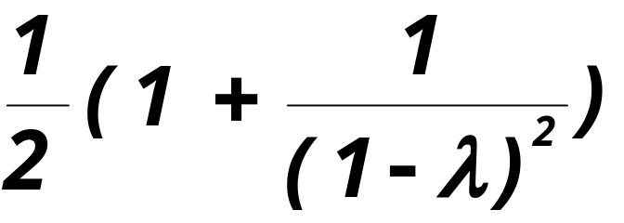
PERFORMANCE
Quite complicated analyses show that the expected number of probes is
for insertions and unsuccessful searches.

Slide 108
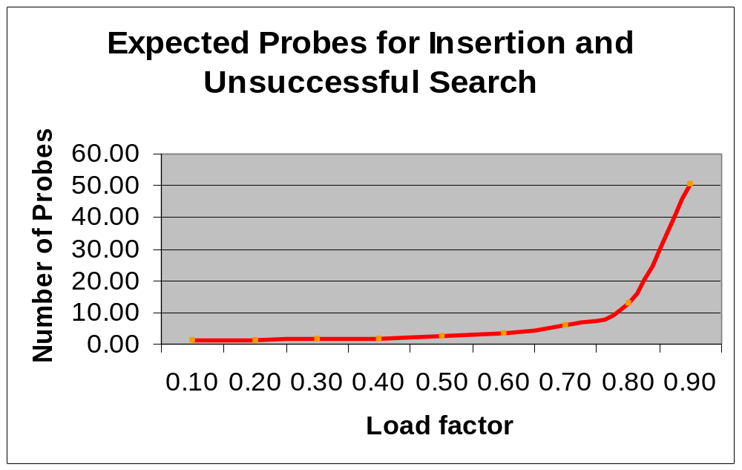
PERFORMANCE
Plot of expected probes versus λ

Slide 109
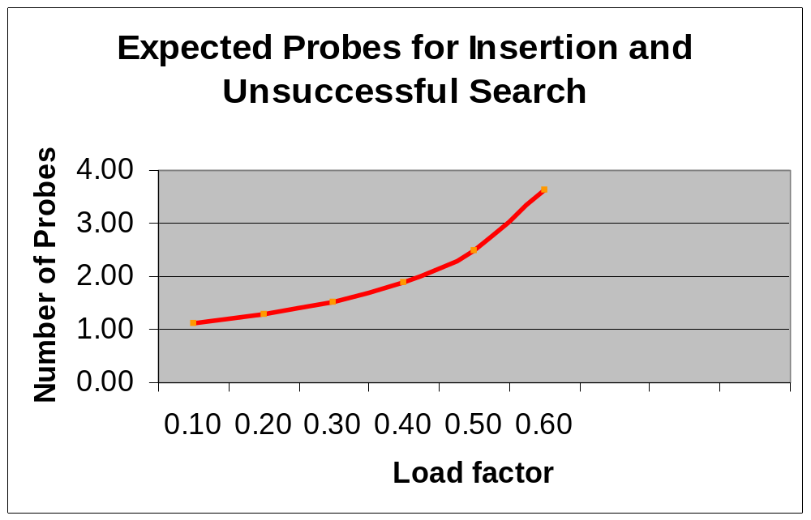
PERFORMANCE
Plot of expected probes versus λ
2.5 probes for λ = 0.5

Slide 110
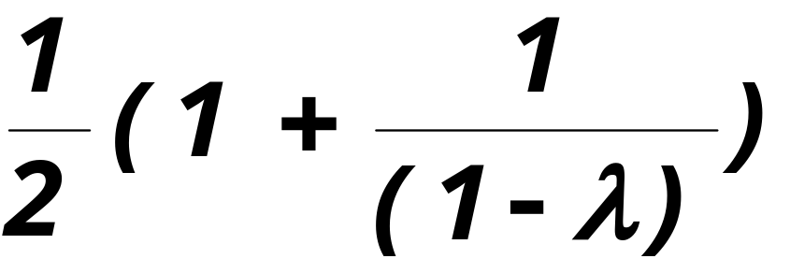
PERFORMANCE
For successful searches the expected number of probes is

Slide 111
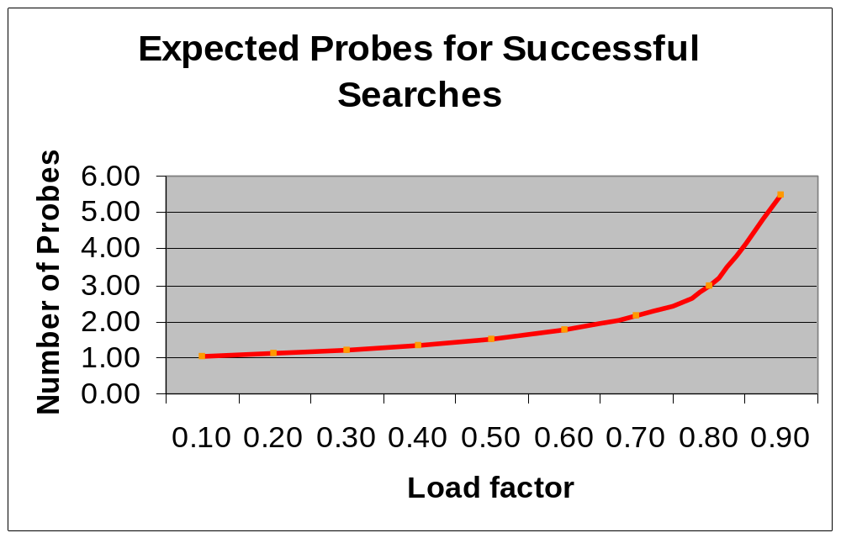
PERFORMANCE

Slide 112
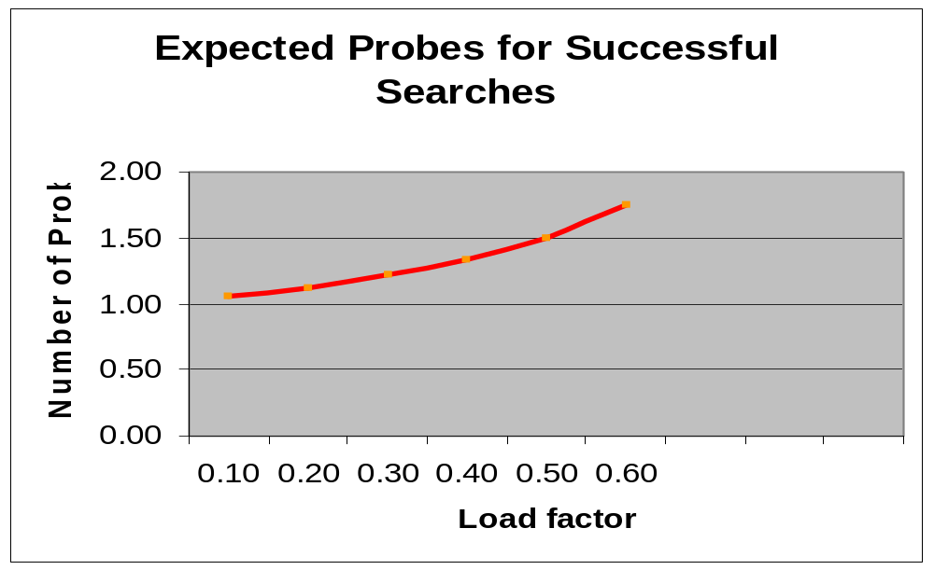
PERFORMANCE

Slide 113
PERFORMANCE

